Slide 1

DIVINE GRACE COLLEGE OF ARTS, SCIENCE AND TECHNOLOGY
(DGCAST) — GAROUA | GEOGRAPHY DEPARTMENT
UPPER SIXTH ARTS — POPULATION GEOGRAPHY — PRACTICAL WORK 2
Population Distribution and Altitude
Mr KAMDEM EMMANUEL
Geography Teacher — PLEG
Academic Year 2026 / 2027
Notes:
Good morning, class. Today we study Practical Work 2: Population Distribution and Altitude.

Slide 2
GEOGRAPHY — UPPER SIXTH ARTS
CLASS INFO
Class, Chapter & Duration
Class | Upper Sixth Arts
Chapter | Module 4: Understanding and managing population dynamics across the world in general and Cameroon in particular
Duration | 2 periods (2 × 50 minutes)
2026 / 2027
DGCAST GAROUA — GEOGRAPHY DEPARTMENT
Mr KAMDEM E. | 2

Slide 3
GEOGRAPHY — UPPER SIXTH ARTS
IDENTIFICATION
Lesson Identification
Topic | Population Numbers
Sub-topic | Population Density and Distribution
Lesson | Practical Work 2: Population Distribution and Altitude
Notions / Concepts | Altitude, altitude zone, population percentage, tropical highlands, temperate lowlands.
Syllabus focus | Analyse, interpret and explain graphs showing the variation of population with altitude.
Competence | Learners are able to read and explain graphs of population by altitude.
2026 / 2027
DGCAST GAROUA — GEOGRAPHY DEPARTMENT
Mr KAMDEM E. | 3

Slide 4
GEOGRAPHY — UPPER SIXTH ARTS
OBJECTIVES
Learning Objectives
By the end of the lesson, the learner should be able to:
Read a graph of population by altitude.
Compare tropical and temperate patterns.
Explain the differences.
2026 / 2027
DGCAST GAROUA — GEOGRAPHY DEPARTMENT
Mr KAMDEM E. | 4

Slide 5
GEOGRAPHY — UPPER SIXTH ARTS
RECALL
Recall
Temperature falls with altitude.
Cool highlands in the tropics can be crowded.
2026 / 2027
DGCAST GAROUA — GEOGRAPHY DEPARTMENT
Mr KAMDEM E. | 5

Slide 6
GEOGRAPHY — UPPER SIXTH ARTS
REAL-LIFE SITUATION
Real-Life Situation
A graph in the textbook shows that in Europe most people live below 500 m, but in Bolivia and Ethiopia many people live above 2,000 m. Learners must explain this difference.
2026 / 2027
DGCAST GAROUA — GEOGRAPHY DEPARTMENT
Mr KAMDEM E. | 6
Notes:
Read the situation slowly, twice.

Slide 7
GEOGRAPHY — UPPER SIXTH ARTS
REAL-LIFE SITUATION
Situation — Question 1
What is the problem in the situation?
2026 / 2027
DGCAST GAROUA — GEOGRAPHY DEPARTMENT
Mr KAMDEM E. | 7

Slide 8
GEOGRAPHY — UPPER SIXTH ARTS
REAL-LIFE SITUATION
Answer
Learners must explain two different patterns.
2026 / 2027
DGCAST GAROUA — GEOGRAPHY DEPARTMENT
Mr KAMDEM E. | 8

Slide 9
GEOGRAPHY — UPPER SIXTH ARTS
REAL-LIFE SITUATION
Situation — Question 2
Where do Europeans mostly live?
2026 / 2027
DGCAST GAROUA — GEOGRAPHY DEPARTMENT
Mr KAMDEM E. | 9

Slide 10
GEOGRAPHY — UPPER SIXTH ARTS
REAL-LIFE SITUATION
Answer
On lowlands below 500 m.
2026 / 2027
DGCAST GAROUA — GEOGRAPHY DEPARTMENT
Mr KAMDEM E. | 10

Slide 11
GEOGRAPHY — UPPER SIXTH ARTS
REAL-LIFE SITUATION
Situation — Question 3
Why do many tropical people live high up?
2026 / 2027
DGCAST GAROUA — GEOGRAPHY DEPARTMENT
Mr KAMDEM E. | 11

Slide 12
GEOGRAPHY — UPPER SIXTH ARTS
REAL-LIFE SITUATION
Possible Answer
The highlands are cooler, healthier and fertile.
2026 / 2027
DGCAST GAROUA — GEOGRAPHY DEPARTMENT
Mr KAMDEM E. | 12

Slide 13
GEOGRAPHY — UPPER SIXTH ARTS
JUSTIFICATION
Justification of the Lesson
This practical work helps us to read graphs and link population to relief and climate.
2026 / 2027
DGCAST GAROUA — GEOGRAPHY DEPARTMENT
Mr KAMDEM E. | 13

Slide 14
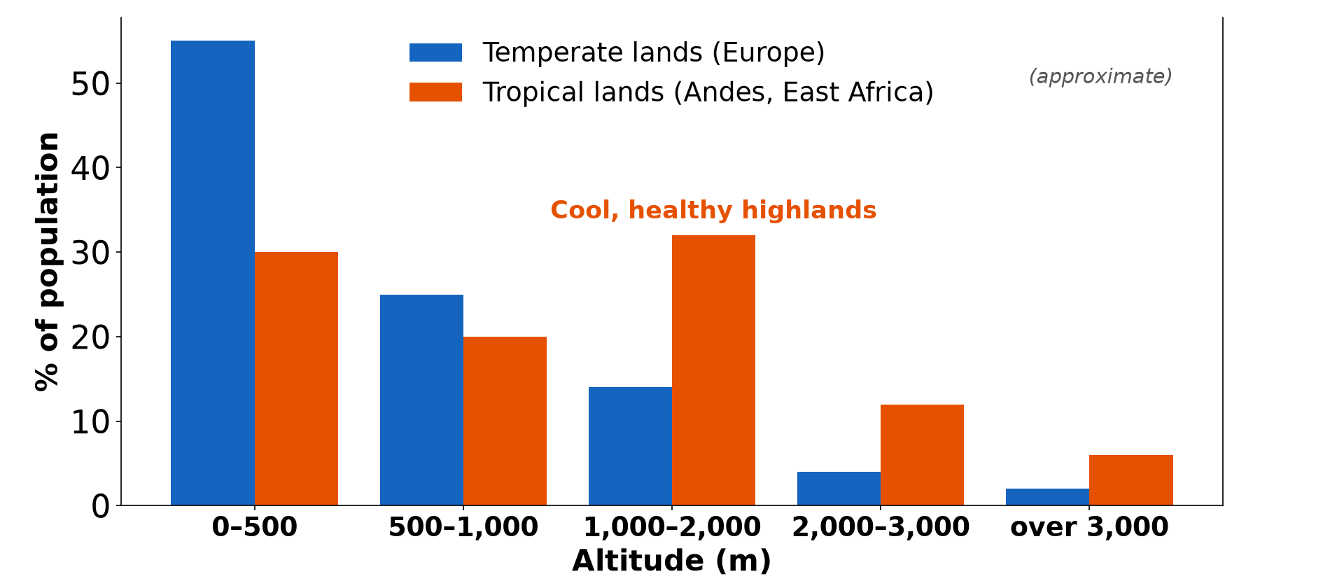
GEOGRAPHY — UPPER SIXTH ARTS
I. READING THE GRAPH
Activity 1
Population by altitude in temperate and tropical lands (approximate).
2026 / 2027
DGCAST GAROUA — GEOGRAPHY DEPARTMENT
Mr KAMDEM E. | 14
Notes:
Without the projector: read the bars one by one.

Slide 15
GEOGRAPHY — UPPER SIXTH ARTS
I. READING THE GRAPH
Activity 1: Question
Which altitude zone has the most people in tropical lands?
2026 / 2027
DGCAST GAROUA — GEOGRAPHY DEPARTMENT
Mr KAMDEM E. | 15

Slide 16
GEOGRAPHY — UPPER SIXTH ARTS
I. READING THE GRAPH
Answer
The 1,000–2,000 m zone (about 32 %).
2026 / 2027
DGCAST GAROUA — GEOGRAPHY DEPARTMENT
Mr KAMDEM E. | 16

Slide 17
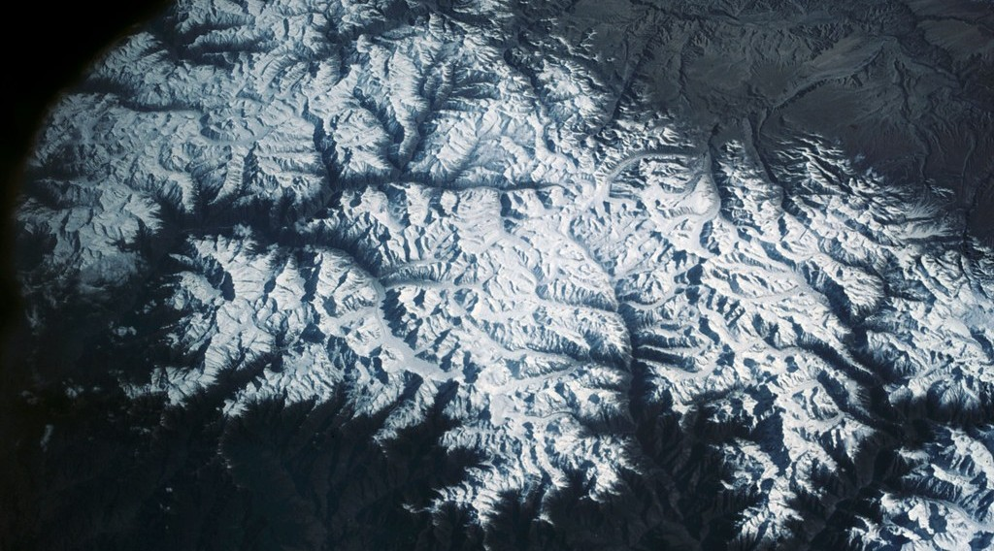
GEOGRAPHY — UPPER SIXTH ARTS
II. TEMPERATE PATTERN
Activity 2
High, cold mountains.
2026 / 2027
DGCAST GAROUA — GEOGRAPHY DEPARTMENT
Mr KAMDEM E. | 17
Notes:
Without the projector: compare the Alps and the plains.

Slide 18
GEOGRAPHY — UPPER SIXTH ARTS
II. TEMPERATE PATTERN
Activity 2: Question
Why does population fall quickly with height in temperate lands?
2026 / 2027
DGCAST GAROUA — GEOGRAPHY DEPARTMENT
Mr KAMDEM E. | 18

Slide 19
GEOGRAPHY — UPPER SIXTH ARTS
II. TEMPERATE PATTERN
Answer
High areas are cold, snowy and have poor soils.
2026 / 2027
DGCAST GAROUA — GEOGRAPHY DEPARTMENT
Mr KAMDEM E. | 19

Slide 20
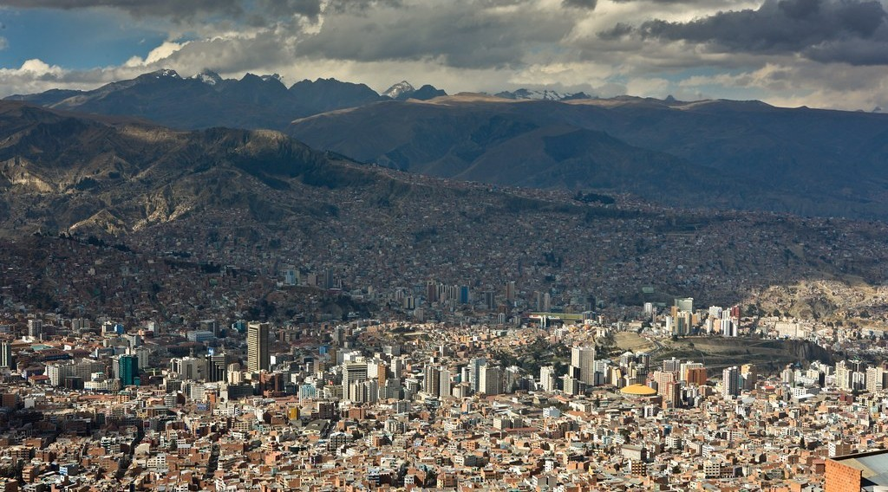
GEOGRAPHY — UPPER SIXTH ARTS
III. TROPICAL PATTERN
Activity 3
La Paz, Bolivia, a large city at about 3,600 m.
2026 / 2027
DGCAST GAROUA — GEOGRAPHY DEPARTMENT
Mr KAMDEM E. | 20
Notes:
Without the projector: find La Paz on the map.

Slide 21
GEOGRAPHY — UPPER SIXTH ARTS
III. TROPICAL PATTERN
Activity 3: Question
Why do many people live high in the Andes?
2026 / 2027
DGCAST GAROUA — GEOGRAPHY DEPARTMENT
Mr KAMDEM E. | 21

Slide 22
GEOGRAPHY — UPPER SIXTH ARTS
III. TROPICAL PATTERN
Answer
The lowlands are hot and unhealthy; the high plateaus are cooler and have mines and farms.
2026 / 2027
DGCAST GAROUA — GEOGRAPHY DEPARTMENT
Mr KAMDEM E. | 22

Slide 23
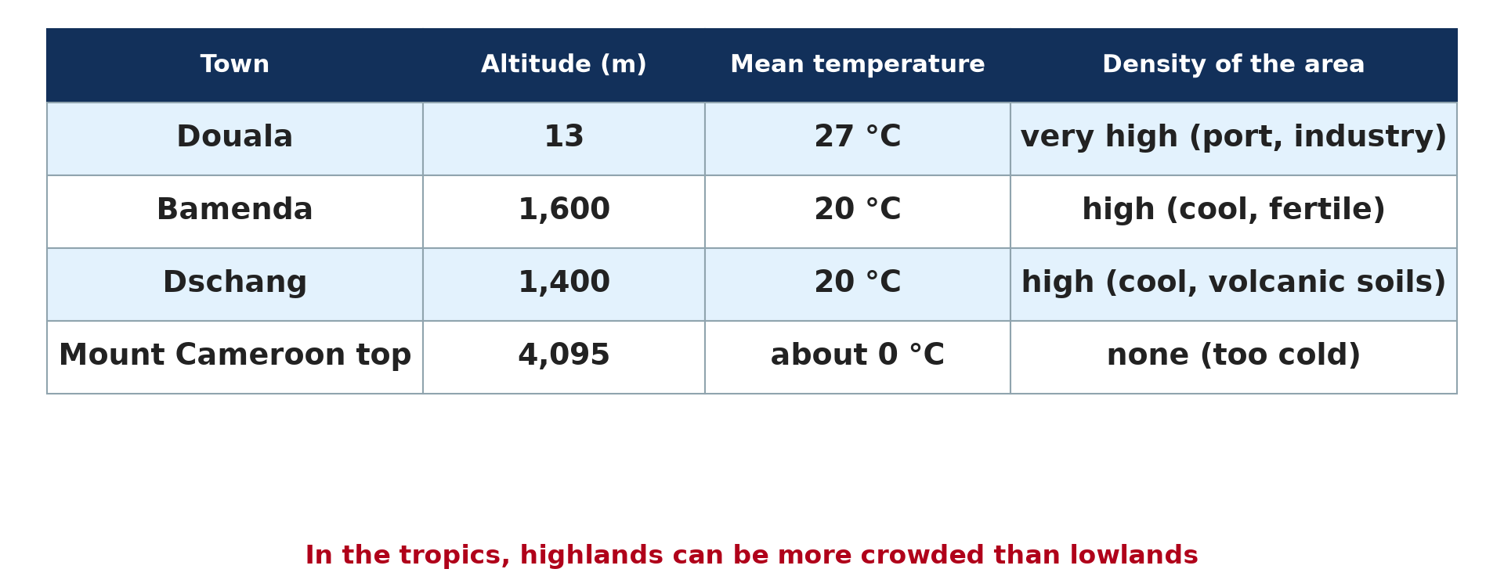
GEOGRAPHY — UPPER SIXTH ARTS
III. CAMEROON
Activity 4
Altitude and density in Cameroon.
2026 / 2027
DGCAST GAROUA — GEOGRAPHY DEPARTMENT
Mr KAMDEM E. | 23
Notes:
Without the projector: compare with Douala.

Slide 24
GEOGRAPHY — UPPER SIXTH ARTS
III. CAMEROON
Activity 4: Question
Why are Bamenda and Dschang densely populated?
2026 / 2027
DGCAST GAROUA — GEOGRAPHY DEPARTMENT
Mr KAMDEM E. | 24

Slide 25
GEOGRAPHY — UPPER SIXTH ARTS
III. CAMEROON
Answer
They are cool, fertile and healthy highlands.
2026 / 2027
DGCAST GAROUA — GEOGRAPHY DEPARTMENT
Mr KAMDEM E. | 25

Slide 26

GEOGRAPHY — UPPER SIXTH ARTS
IV. EXPLANATION
Activity 5
Farms on cool highlands.
2026 / 2027
DGCAST GAROUA — GEOGRAPHY DEPARTMENT
Mr KAMDEM E. | 26
Notes:
Without the projector: write the reasons.

Slide 27
GEOGRAPHY — UPPER SIXTH ARTS
IV. EXPLANATION
Activity 5: Question
Give two reasons for the tropical pattern.
2026 / 2027
DGCAST GAROUA — GEOGRAPHY DEPARTMENT
Mr KAMDEM E. | 27

Slide 28
GEOGRAPHY — UPPER SIXTH ARTS
IV. EXPLANATION
Answer
Cooler climate with fewer diseases, and fertile volcanic soils.
2026 / 2027
DGCAST GAROUA — GEOGRAPHY DEPARTMENT
Mr KAMDEM E. | 28

Slide 29
GEOGRAPHY — UPPER SIXTH ARTS
BOARD SUMMARY
Population Distribution and Altitude
Topic: Population Numbers
Sub-topic: Population Density and Distribution
Practical Work 2: Population Distribution and Altitude
2026 / 2027
DGCAST GAROUA — GEOGRAPHY DEPARTMENT
Mr KAMDEM E. | 29
Notes:
Learners copy the board summary now. Give them enough time for each slide.

Slide 30
GEOGRAPHY — UPPER SIXTH ARTS
BOARD SUMMARY
I. Definitions
Altitude zone: It is a band of land between two heights.
Percentage of population: It is the share of the people living in each zone.
2026 / 2027
DGCAST GAROUA — GEOGRAPHY DEPARTMENT
Mr KAMDEM E. | 30

Slide 31
GEOGRAPHY — UPPER SIXTH ARTS
BOARD SUMMARY
II. Reading the Graphs
A. Temperate pattern: Most people live below 500 m, and numbers fall with height. High mountains are almost empty.
B. Tropical pattern: Many people live between 1,000 and 3,000 m. Highlands like the Andes and Ethiopia are crowded.
2026 / 2027
DGCAST GAROUA — GEOGRAPHY DEPARTMENT
Mr KAMDEM E. | 31

Slide 32
GEOGRAPHY — UPPER SIXTH ARTS
BOARD SUMMARY
III. Explanation (1/2)
A. Temperate lands: Lowlands are warm, fertile and easy for transport and industry. Highlands are cold and have short growing seasons.
B. Tropical lands: Hot lowlands have heat, humidity and diseases like malaria. Highlands are cooler, healthier and often fertile.
2026 / 2027
DGCAST GAROUA — GEOGRAPHY DEPARTMENT
Mr KAMDEM E. | 32

Slide 33
GEOGRAPHY — UPPER SIXTH ARTS
BOARD SUMMARY
III. Explanation (2/2)
C. Cameroon: The Western Highlands are densely populated for these reasons. Very high areas like the top of Mount Cameroon remain empty.
2026 / 2027
DGCAST GAROUA — GEOGRAPHY DEPARTMENT
Mr KAMDEM E. | 33

Slide 34
GEOGRAPHY — UPPER SIXTH ARTS
FORMATIVE EVALUATION
Formative Evaluation 1
Describe the tropical pattern of population with altitude.
2026 / 2027
DGCAST GAROUA — GEOGRAPHY DEPARTMENT
Mr KAMDEM E. | 34

Slide 35
GEOGRAPHY — UPPER SIXTH ARTS
FORMATIVE EVALUATION
Expected Answer
Many people live at 1,000–3,000 m; highlands are crowded.
2026 / 2027
DGCAST GAROUA — GEOGRAPHY DEPARTMENT
Mr KAMDEM E. | 35

Slide 36
GEOGRAPHY — UPPER SIXTH ARTS
FORMATIVE EVALUATION
Formative Evaluation 2
Why are lowlands preferred in temperate lands?
2026 / 2027
DGCAST GAROUA — GEOGRAPHY DEPARTMENT
Mr KAMDEM E. | 36

Slide 37
GEOGRAPHY — UPPER SIXTH ARTS
FORMATIVE EVALUATION
Expected Answer
They are warmer, fertile and easy to use for transport and industry.
2026 / 2027
DGCAST GAROUA — GEOGRAPHY DEPARTMENT
Mr KAMDEM E. | 37

Slide 38
GEOGRAPHY — UPPER SIXTH ARTS
REMEDIATION
Remediation
Fill in the blanks:
In Europe most people live below ______ m.
La Paz lies in the ______ Mountains.
Highlands in the tropics are cooler and ______.
2026 / 2027
DGCAST GAROUA — GEOGRAPHY DEPARTMENT
Mr KAMDEM E. | 38
Notes:
Answers: 1. 500 2. Andes 3. healthier

Slide 39
GEOGRAPHY — UPPER SIXTH ARTS
HOMEWORK
Homework
Draw a bar graph of population by altitude from the table and write three sentences about it.
This prepares Lesson 4: Modifications of Population Distribution.
2026 / 2027
DGCAST GAROUA — GEOGRAPHY DEPARTMENT
Mr KAMDEM E. | 39
Notes:
This homework prepares the next lesson.

Slide 40
GEOGRAPHY — UPPER SIXTH ARTS
BILINGUAL GAME
Bilingual Game (Jeu Bilingue)
English | Français
Altitude | L'altitude
Graph | Le graphique
Highland | Le haut plateau
Lowland | La plaine
Malaria | Le paludisme
Share | La part
2026 / 2027
DGCAST GAROUA — GEOGRAPHY DEPARTMENT
Mr KAMDEM E. | 40
Notes:
Say the English word; learners give the French word, then the reverse.

Slide 41
GEOGRAPHY — UPPER SIXTH ARTS
LOGBOOK
Official Logbook (1/2)
Module / Topic | Population Numbers
Lesson Title | Practical Work 2: Population Distribution and Altitude
Expected Learning Outcomes | Read a graph of population by altitude. Compare tropical and temperate patterns. Explain the differences.
Competence | Learners are able to read and explain graphs of population by altitude.
2026 / 2027
DGCAST GAROUA — GEOGRAPHY DEPARTMENT
Mr KAMDEM E. | 41

Slide 42
GEOGRAPHY — UPPER SIXTH ARTS
LOGBOOK
Official Logbook (2/2)
Matter Taught | I. Definitions: Altitude zone, Percentage of population; II. Reading the Graphs: Temperate pattern, Tropical pattern; III. Explanation: Temperate lands, Tropical lands, Cameroon.
Evaluation | Formative evaluation (3 questions) and remediation exercise.
Homework | Draw a bar graph of population by altitude from the table and write three sentences about it.
Enrolment / Present / Absent | ____ / ____ / ____
Achievement | To be completed by the teacher after the lesson.
2026 / 2027
DGCAST GAROUA — GEOGRAPHY DEPARTMENT
Mr KAMDEM E. | 42

Slide 43
GEOGRAPHY — UPPER SIXTH ARTS
TEACHER'S NOTE
Teacher's Note
Timing: Set-up, recall 8 min | Situation 8 min | 5 activities 30 min | Board summary (copying) 30 min | Evaluation, remediation 10 min | Homework, logbook 9 min | Spare 5 min
2026 / 2027
DGCAST GAROUA — GEOGRAPHY DEPARTMENT
Mr KAMDEM E. | 43

Slide 44
GEOGRAPHY — UPPER SIXTH ARTS
REFERENCES
References
National Geography Syllabus, Sixth Forms (Lower & Upper Sixth), MINESEC/IGE/IP-SS, August 2019 — Module 4 (Population Geography).
Photo, Activity 2: “View of the Himalaya Mountain Range” by NASA Johnson, CC BY-NC 2.0, via nasa (https://www.flickr.com/photos/29988733@N04/10678470543)
Photo, Activity 3: “La Paz” by cliff.hellis, CC BY-NC-ND 2.0, via Flickr (https://www.flickr.com/photos/30099537@N02/6348597083)
Photo, Activity 5: “Carlo in the tea” by luigig, CC BY 2.0, via Flickr (https://www.flickr.com/photos/51035803402@N01/3175986747)
Diagrams and animations: drawn for this lesson (DGCAST Geography Department).
2026 / 2027
DGCAST GAROUA — GEOGRAPHY DEPARTMENT
Mr KAMDEM E. | 44

